Slide 1
“Gesture Control Automated Vehicle”
Mini Project – I
Risheek D S 1NH19EC412
Prashanth B 1NH18EC088
VB Vasu 1NH18EC115
M Rishi 1NH18EC070
Guided By
Mr.Anush G R
Assistant Professor
Dept. of ECE
New Horizon College of Engineering, Bengaluru

Slide 2
Contents
Introduction
Problem Statement & Objectives
Proposed System
Block Diagram
Hardware & Software Specification
Circuit Diagram & Working
Algorithm / Flow Chart
Results
Advantages
References
Progress Work
Milestones/Schedule

Slide 3
Introduction
Nowadays, robotics are becoming one of the most advanced in the field of technology. A Robot is an electro-mechanical system that is operated by a computer program. Robots can be autonomous or semi-autonomous. An autonomous robot is not controlled by human and acts on its own decision by sensing its environment.
Majority of the industrial robots are autonomous as they are required to operate at high speed and with great accuracy. But some applications require semi-autonomous or human controlled robots. There are different ways to control robotic arm like Voice Controlled, Keypad Control, Gesture Control, etc…
A Gesture Controlled robot is a kind of robot which can be controlled by your hand gestures not by old buttons . You just need to wear a small transmitting device in your hand which included an acceleration meter . This will transmit an appropriate command to the robot so that it can do whatever we want. As our project is already divided into two different part transmitter and receiver

Slide 4
The applications of robotics mainly involve in automobiles, medical, construction, defense and also used as a fire fighting robot to help the people from the fire accident.
But, controlling the robot with a remote or a switch is quite complicated. So, a new project is developed that is, an accelerometer based gesture control robot.
The main goal of this project is to control the movement of the robot with hand gesture using accelerometer . The robot is usually an electro-mechanical machine that can perform tasks automatically. Some robots require some degree of guidance, which may be done using a remote control or with a computer interface. Robots can be autonomous, semi-autonomous or remotely controlled.
Human hand motion are received by the wire connected to the accelerometer. The robots travel by motion made by the user hand tilting.

Slide 5
Problem Statement & Objectives
Problem Statement :
Accelerometer signals are received and assisted with wired correspondence. The robot moves depends upon the signal made by your hand and from a separation.
Objectives:
The objective of this project is to show the control of the robot by wirelessly and using the accelerometer with the help of human hand tilting. Accelerometer signals are received and assisted with wired correspondence. The robot moves depends upon the signal made by your hand.
The normal wired buttons controlled robot becomes very bulgy and it also limits the distance the robot goes. The Wireless Hand controlled Robot will function by a wearable hand glove from which the movements of the hand can be used as the input for the movement of the robot. The basic idea of our project is to develop a system (Robot) which can recognize the Human Interaction with it to accomplish the certain tasks assigned to it.
In this project user is also able to control motions of the car by wearing controller glove and performing predefined gestures. This can be also used in many potential applications such as wireless controller car racing etc.

Slide 6
Proposed System
The proposed system, in which the user can navigate the wireless robot in the environment using various gestures commands. The main objective is to provide reliable and a more natural technique for the user to navigate a wireless robot in the environment using gestures. The proposed system will give the intelligent system which can controlled by the hand gestures, it works on the device accelerometer which has transmitter and receiver.

Slide 7
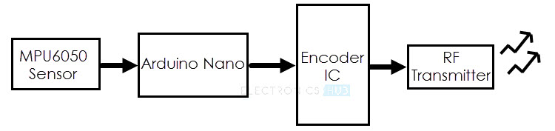
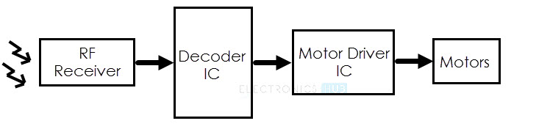
Block Diagram
Robot

Slide 8
Hardware & Software Specification
Hardware Description:
Arduino Board
Accelerometer
Motor driver
DC Motor
Battery
RF Transmitter and Receiver
Software Description:
Arduino nano

Slide 9
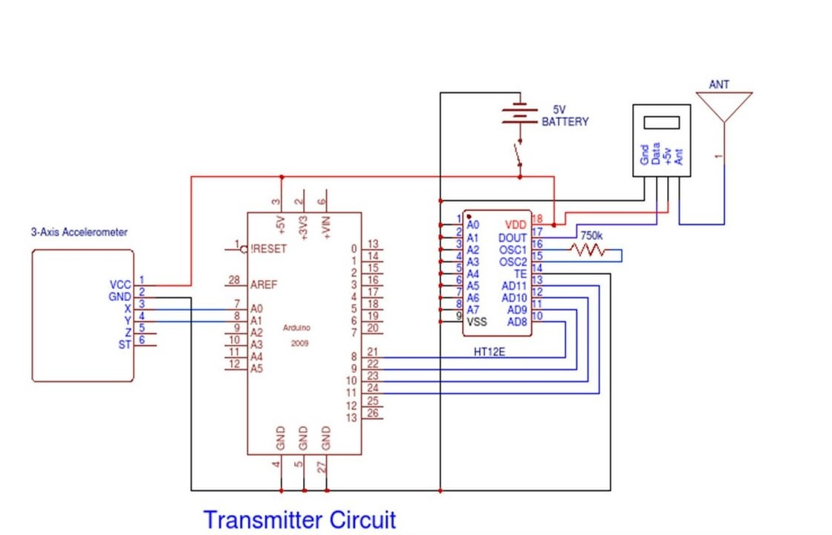
Circuit Diagram & Working

Slide 10
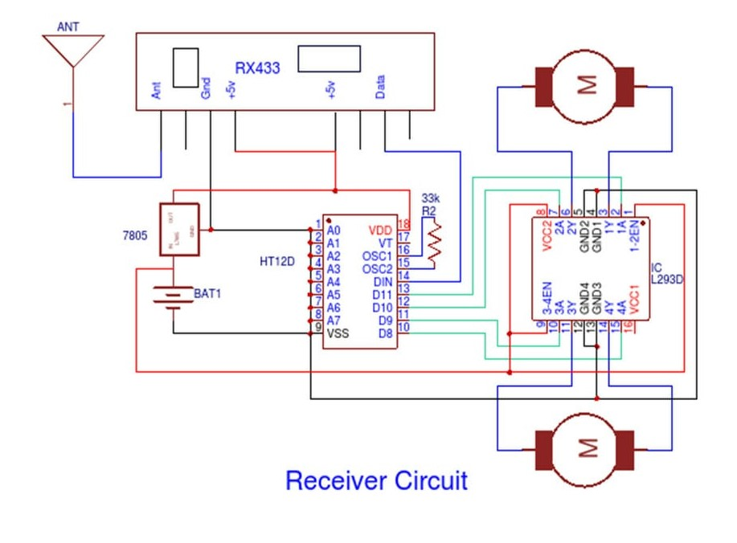

Slide 11
Gesture Controlled Robot is divided into two sections:
1.Transmitter part : 2. Receiver part :
Accelerometer RF receiver
Arduino nano Decoder
Encoder Motor driver
RF transmitter Motor
In transmitter part an accelerometer and a RF transmitter unit is used. As we have already discussed that accelerometer gives an analog output so here we need to convert this analog data in to digital. For this purpose we have used 4 channel comparator circuit in place of any ADC. By setting reference voltage we gets a digital signal and then apply this signal to HT12E encoder to encode data or converting it into serial form and then send this data by using RF transmitter into the environment.
At the receiver end we have used RF receiver to receive data and then applied to HT12D decoder. This decoder IC converts received serial data to parallel and then read by using Arduino . According to received data we drive robot by using two DC motor in forward, reverse, left, right and stop direction

Slide 12
Algorithm / Flow Chart
HAND MOVEMENT
COLLECTION OF ACCELEROMETER DATA
PROCESSING (ENCODING)
TRANSMISSION MEDIUM (AIR)
RECEIVING DATA
FLOWCHART (DATA FLOW)
PROCESSING (DECODING)
MICROCONTROLLER(ARDUINO NANO)
MOTOR DRIVER
MOTOR
MOVEMENT OF VEHICLE

Slide 13
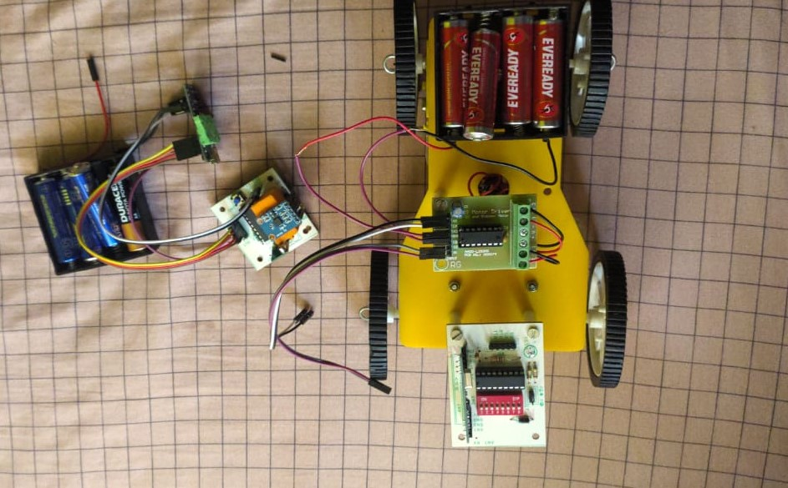
Results & Discussion

Slide 14
Advantages
Wireless controlled robots are very useful in many applications like remote surveillance, military etc.
Hand gesture controlled robot can be used by physically challenged in wheelchairs.
Through the use of gesture recognition, remote control with the wave of a hand of various devices is possible.
Developing system will save the electricity and it benefit the Indian economy.
It will save the life of human beings in the dangerous zones.
Far objects can be easily identified through webcam.
It is cheap so it can be produced and used for number of purposes.

Slide 15
Conclusion & Future Scope
Conclusion:
In this project, a programmed component has been built up that works in accordance with your hand signal. The system moves remotely in accordance with palm signal. The RF module is operating on the frequency of 433 megahertz and
consists of a circulate of 40-70 meters.
Future Scope:
An on-board camera can be installed for monitoring the robot from faraway places.
All we need is a wireless camera which will broadcast and a receiver
module which will provide live streaming.
This robots can be upgraded to detect human life styles earthquake and landslide by ways of enforcing the sensor therefore it can also be upgraded to bomb detecting
robot because it has robotic arm it may additionally elevate the bomb which is Positioned at distant location.
And these type of methodology can be used in rescue operation to view the sight without any complexity.

Slide 16
References
[1] Kun and W. T. Miller.: Adaptive dynamic balance of abiped robot using neural networks, IEEE Conference on Robotics and Automation,pp. 240- 245, 1996.
[2] http://www.instructables.com/id/Gesture-controlled-robotusing-Arduino/
[3] https://www.elprocus.com/accelerometer-based-gesturecontrol-robot/rolled-robotusing-Arduino/

Slide 17
Progress Work
Group – Prashanth, Risheek , Rishi ,Vasu | Work Achieved
ALL | Title / Project selection
ALL | Selecting and bringing Components
ALL | Making project
ALL | PPT

Slide 18
Milestones/Schedule
Milestone | Baseline Date | Target Date | Achievement
Title of the project | 18/092020 | 26/09/2020 | Success
Approval of the project | - | 05/10/2020 | Success
First review | 02/11/2020 | 07/11/2020

Slide 19
Thank You

